Slide 1
WAES1102
Cognitive Science

Slide 2
Cognitive Science
What is it?
Multi-disciplinary research about mind and natural intelligence.
Knowledge representation and how it the information being manipulated

Slide 3
Cognitive Psychology
What is it?
Scientific study of the thinking mind and is concerned with:
How we attend to and gain information about the world.
How that information is stored and processed by the brain.
How we solve problems, think and formulate language.

Slide 4
Cognitive Psychology Domain
Cognitive neuroscience
Human and
artificial intelligence
Perception
Thinking and
concept formation
Pattern recognition
Cognitive
Psychology
Development
psychology
Attention
Language
Consciousness
Imagery
Memory
Representation of knowledge

Slide 5
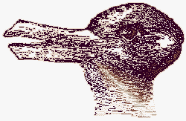
Perception – Optical illusion
What do you see?

Slide 6

Perception – Optical illusion
What do you see?

Slide 7

Perception – Optical illusion
What do you see?

Slide 8
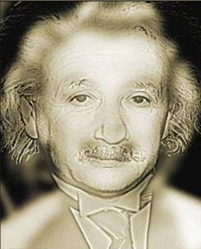
Perception – Optical illusion
What do you see?

Slide 9


Slide 10
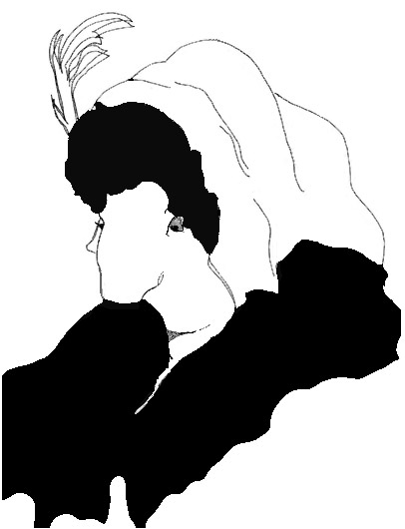
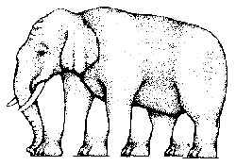
How many legs does this elephant have?
Guess this woman’s age?

Slide 11
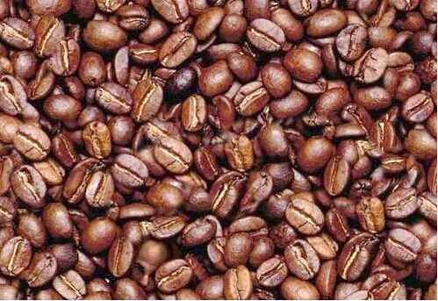
Find a face?

Slide 12
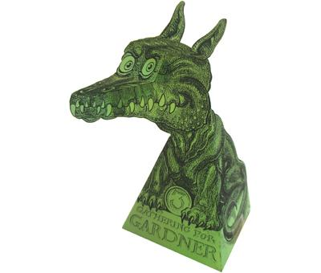
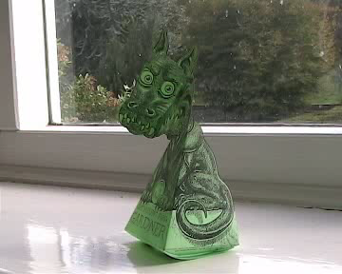
Something interesting to try…
This little dragon is made out of paper - you simply cut it out and stick it together, and stand it on a table or window ledge. But when you move around, the dragon's head seems to follow you around the room. Click on the dragon to download and try the illusion yourself. Have a look at the video too..
Click the video above…

Slide 14
Gestalt principles
These illusions happen because the mind groups patterns according to rules called the laws of perceptual organization.
A series of rules that specifies how we perceptually organize parts into groups
Principle :
Simplicity/Good figure
Similarity
Good continuation
Proximity
Common fate
Familiarity

Slide 15
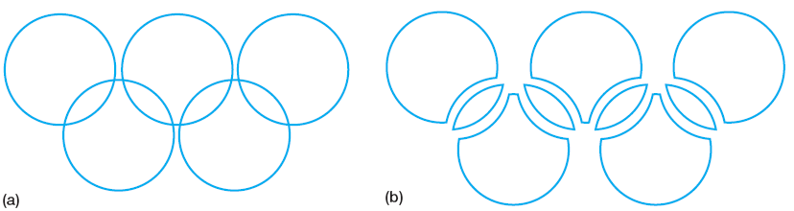
Gestalt law 1 : Good figure/simplicity
Every stimulus pattern is seen in such a way that the resulting structure is as simple as possible
E.g: Olympic symbol

Slide 16
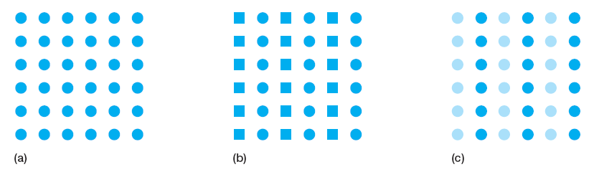
Gestalt law 2 : Similarity
Similar things appear to be grouped together
Based on sizes, shapes, lightness, hue, orientation

Slide 17
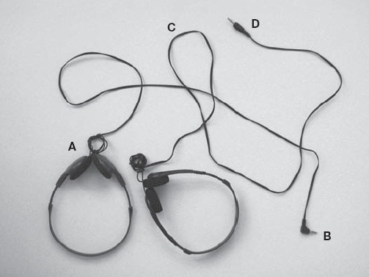

Gestalt law 3: Good continuation
Points that, when connected, result in straight or smoothly curving lines, are seen as belonging together, and the lines tend to be seen as following the smoothest path.

Slide 18
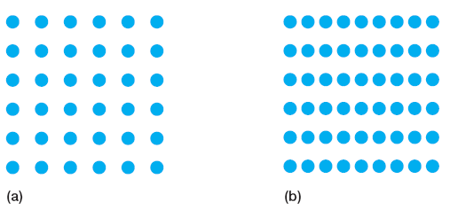
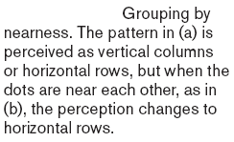
Gestalt law 4 : Proximity
Things that are near to each other appear to be grouped together

Slide 19
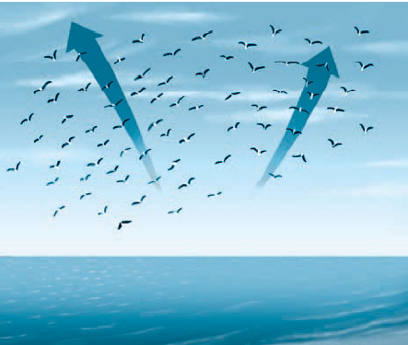
Gestalt law 5 : Common fate
Things that are moving in the same direction appear to be grouped together
E.g. : flock of hundreds of birds all flying together, you tend to see the flock as a unit, if some birds start flying in another direction, this creates a new unit

Slide 20

Gestalt law 6 : Familiarity
Things are more likely to appear as groups if the groups appear familiar and meaningful

Slide 21
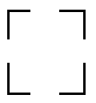
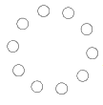

Gestalt law 7 : Closure
Things are likely to be seen as complete figures even when part of the information is missing

Slide 22
Other Example
STOP WAR
STOP
PEACE
WAR
NOW
PEACE NOW
Here, the background shading exerts a powerful influence over the message being read. It is likely that common regions help organize the text.

Slide 23
Other Example
Look at this display of triangles. In which direction do they point? Look again. Does the direction change? Can you control the direction?

Slide 24
Visual Imagery - Mental rotation
Task : Rapidly indicate whether two pictures were of the same or of different objects
Individual activity:
**Any volunteers? **
http://www.cambridgebrainsciences.com/play/rotation-task

Slide 25
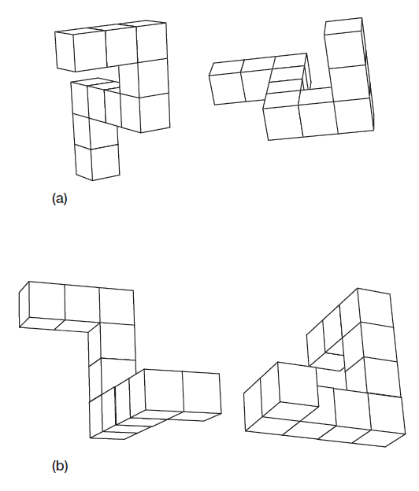
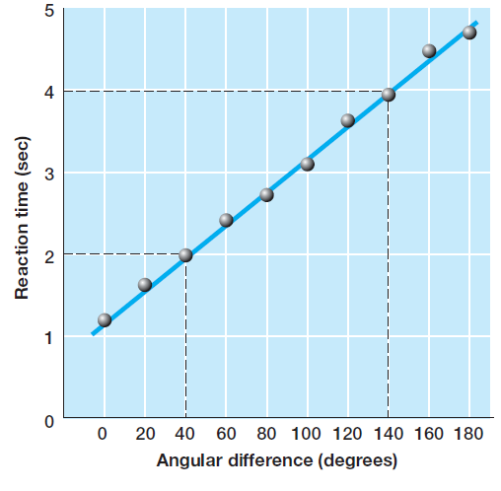
Outcome : Time to compare object of larger > smaller angle
Smaller angle
Larger angle

Slide 26
Attention

Slide 27
Attention
What were you aware and unaware of the contents in the previous video?
Selective attention : process by which a person can selectively pick out one message from a mixture of messages occurring simultaneously
Moray (1959) : showed participants, unaware of words repeated 35 times in unattended ear

Slide 28
Attention
General definition:
The concentration of mental effort on sensory or mental events.
Five major aspects:
Processing capacity and selective attention
Level of arousal
Control of attention
Consciousness
Cognitive neuroscience

Slide 29
Attention
Five issues of attention
Processing capacity
We can attend to some, but not all, cues in our external world.
Control
We have some control over the stimuli we attend to.
Automatic processing
Many routine processes are so familiar they require little conscious attention and are done automatically.
Neurocognition
Our brain is the anatomical support for attention, as well as cognition.
Consciousness
Attention brings events into consciousness.

Slide 30
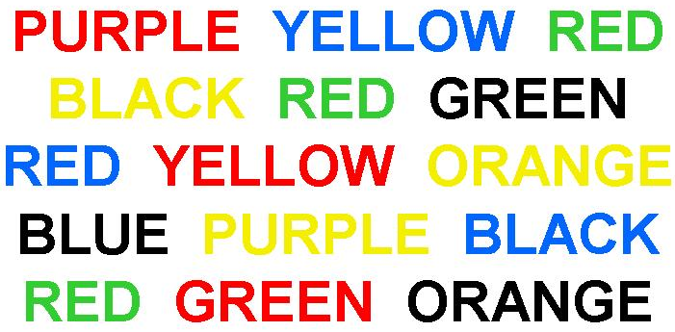
Task : Say the colour, don’t read the word..
STROOP EFFECT

Slide 31
Attention – Stroop effect
JR Stroop (1935)
difficult to say out the ink colour, than to read the word
caused by people’s inability to avoid paying attention to the meanings of the words, even though they are instructed to ignore them
reading is highly practiced and has become so automatic that it is difficult not to read them

Slide 32
Why is the SIGNIFICANCE in learning cognitive science?
Fundamental study before developing an intelligent machine
Adapt way of thinking like human does
Develop a smart system that can give the biggest impact to society
E.g. create an advertisement that is memorable
Improving available system by integrate with new way of thinking

